Slide 1
API INTEGRATION WITH API GATEWAY

Slide 2
Project Overview
This project focused on exposing an AWS Lambda function to the internet by creating a RESTful API using Amazon API Gateway.
The goal was to gain practical experience in integrating serverless compute with API endpoints, enabling external clients to interact with backend functions securely and efficiently.

Slide 3
Objectives
Design and deploy a publicly accessible API.
Integrate AWS Lambda functions with Amazon API Gateway.
Test API endpoints to ensure proper functionality and response handling.

Slide 4
Services Used
Amazon API Gateway – for creating, managing, and deploying APIs.
AWS Lambda – for executing serverless backend functions.

Slide 5
Key Responsibilities
Developed Lambda functions to handle API requests and return responses.
Configured API Gateway to create secure and publicly accessible endpoints.
Integrated Lambda functions with API Gateway to enable seamless execution.
Tested API endpoints to ensure reliability and correct data output.
Implemented best practices for serverless architecture and API management.

Slide 6
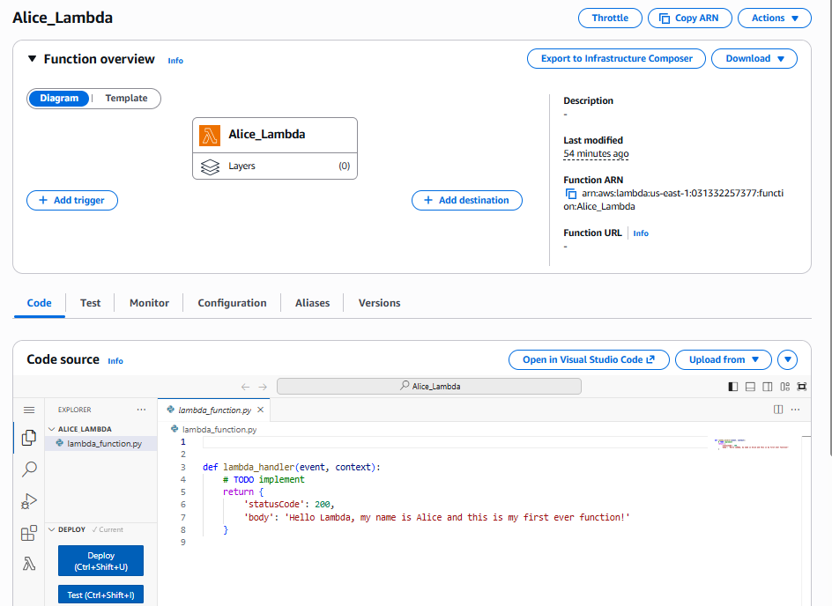
Developed Lambda functions to handle API requests and return responses.

Slide 7
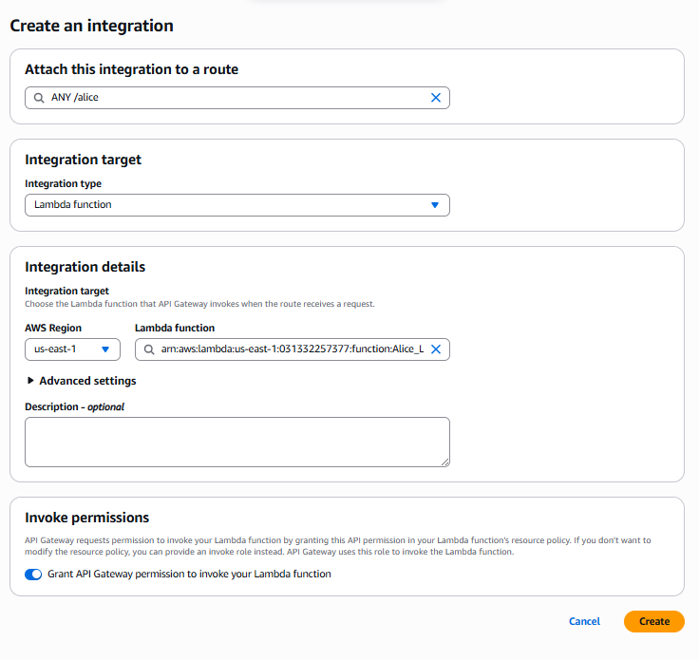
Configured API Gateway to create secure and publicly accessible endpoints

Slide 8
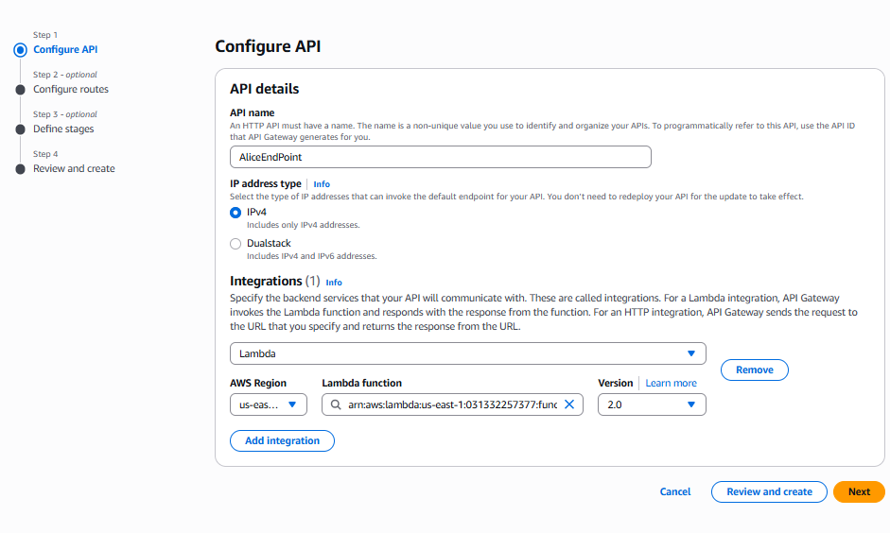
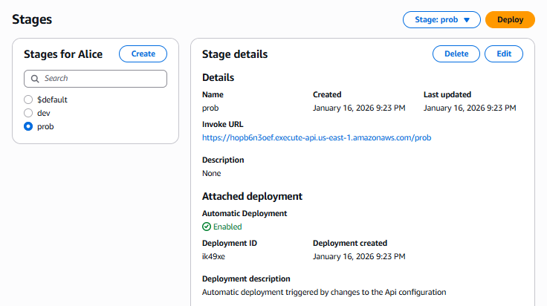
Integrated Lambda functions with API Gateway to enable seamless execution.

Slide 9
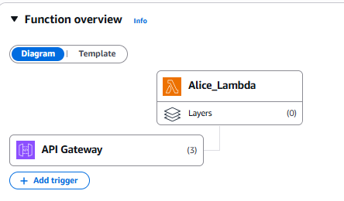
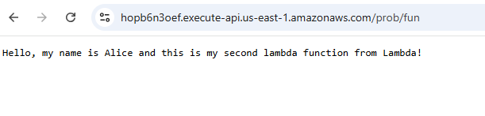
Tested API endpoints to ensure reliability and correct data output.

Slide 10
Results & Outcomes
Successfully deployed a publicly accessible API endpoint using Amazon API Gateway integrated with AWS Lambda.
Verified end-to-end request flow from client → API Gateway → Lambda, confirming correct routing and execution.
Identified and resolved a critical routing issue by understanding that API Gateway requires the defined route path to be included in the invoke URL for successful Lambda invocation.
Gained hands-on experience troubleshooting serverless APIs, reinforcing the importance of route configuration, stage deployment, and URL structure in API Gateway.
Improved practical debugging skills by systematically validating configurations rather than relying on assumptions.

Slide 11
Skills Gained
Serverless architecture using AWS Lambda and Amazon API Gateway
RESTful API design and deployment
API Gateway routing and URL structure
Serverless integration and request flow analysis
Cloud troubleshooting and debugging
AWS console navigation and service integration

Slide 12
Conclusion
This project reinforced key skills in serverless architecture and cloud service integration. By successfully exposing a Lambda function via API Gateway, it demonstrated how cloud-native services can be combined to build scalable and secure APIs.
The experience gained provides a solid foundation for developing more complex serverless applications and integrating multiple AWS services in real-world projects.

